Slide 1

InstaDr.
Your personalised health companion
.
Team:
Abhishek Mandal Ayan chakraborty Rebanta Chakraborty
Sourjya Dey
30th January, 2021

Slide 2
Login / Registration page:
CONSTRAINTS / PARAMETERS:
For Registered Users:
EMAIL ID or PERSONAL CONTACT NUMBER
PASSWORD
For Unregistered Users:
FIRST NAME
LAST NAME
REGISTERED EMAIL ID or PERSONAL CONTACT NUMBER
COUNTRY , STATE , CITY AND RESIDENTIAL ADDRESS WITH PROOF
DATE OF BIRTH and AGE WITH PROOF
CONFIRMED PASSWORD
BENEFITS:
To uniquely identify each individual and connect with them easily. In case of any medical emergency , all the services of the app will be available to the user at an instant. It will , without any doubt contribute towards a hassle free experience of the software.
●

Slide 3
BASIC DETAILS FILL UP:
CONSTRAINTS / PARAMETERS:
BLOOD GROUP 2.MEDICAL HISTORY
CHRONIC DISEASE(s) [if any]
ALLERGY(ies) [if any]
CONTACT NUMBER OF FAMILY PHYSICIAN [if any]
PREVIOUS MEDICAL PRESCRIPTIONS
BENEFITS:
To keep a record of the medical attention needed by the user and ensure that during any crisis period , medical treatment is given to the user at the earliest without wasting any time in gathering the fundamental knowledge about the patient. In case of any pre-recorded allergic reactions of the patient to any drugs , the app will take care not to suggest it or suggest alternatives to the drug. The call to the family physician would be just one tap away and in case of a meeting with a physician , the app will keep all of your medical information ready. The app can also provide reminders for buying medicines that are needed by the user on a frequent basis.

Slide 4
A F RIENDLY A.I CHATBOT AT YOUR SERVICE:
A friendly chatbot will always be at your service 24 X 7 . The chatbot is aimed at making the user’s experience with the app even more subtle and smooth. All the functions of the app , from calling the family physician to setting up a sleep routine will be in the control of the user’s voice. The bot is even trained with basic social interactions for the user’s time pass. The bot would be smart enough to know the user’s voice and won’t share any confidential information with anyone without the user’s permission. The user gets to select between two versions of the chatbot ,a male version and a female version.
THE “INSTA AMBULANCE“ FEATURE:
The “Insta Ambulance” feature allows you to call for an ambulance from the nearest hospital in your neighbourhood at an instant , in just one tap. This feature will subsequently cut off any delays needed for emergency treatment of the patient. The tap button shall be embedded in the home screen of the user’s device for instant access. As mentioned earlier , the documents which the user provides to validate his/her identity will allow them to enable this feature.
THE 24 x 7 HOSPITAL MONITORING SYSTEM:
The app will automatically monitor the vacancy of hospitals nearest to the user’s residence and notify the best and budget friendly hospital available(the price is to be set by the user).

Slide 5
NECESSARY FRAMEWORKS OF THE APP:
Framework/Technologies to be used-
Flutter (by Google) -
No need of 2 teams to work on an ios and an android version of the same app.
Helps produce a responsive user interface.
MongoDB -
Provides Cross Platform document-oriented database program.
Helps to manage a database that will include Client sided information and their service details.
It is easy to add new innovative features that require dynamic database services.

Slide 6
Firebase -
Can have Easy deployment of the app.
Authentication made easy.
Analysis is easier and also we can add chat features in the app for customer support.
Google Cloud Platform -
We can add customer services to communicate with the user and client.
Resolve security issues.
We can manage data and use analytics. Access to Google maps and API tools.

Slide 7
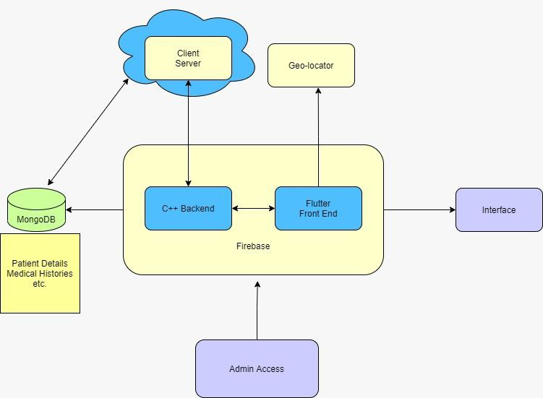
Geolocator (Flutter) -
For location services.
OVERALL STRUCTURE:

Slide 8
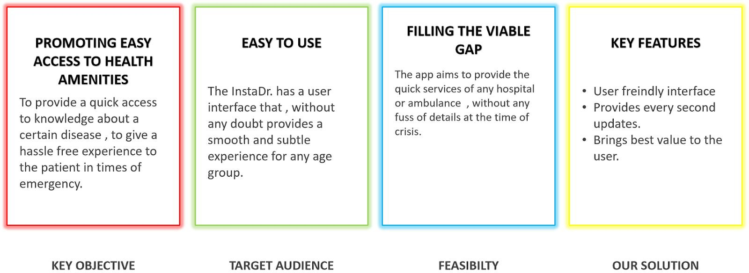
THE BUSINESS MODEL:

Slide 9
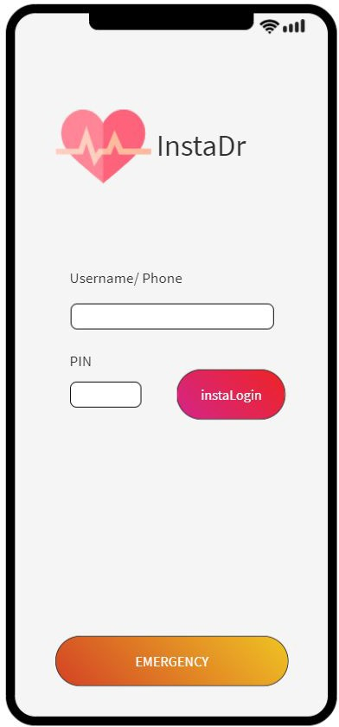

Slide 10
THANK YOU

